Slide 1
Curriculum vitae
Joy Debnath
2111217
CIS-101-11

Slide 2
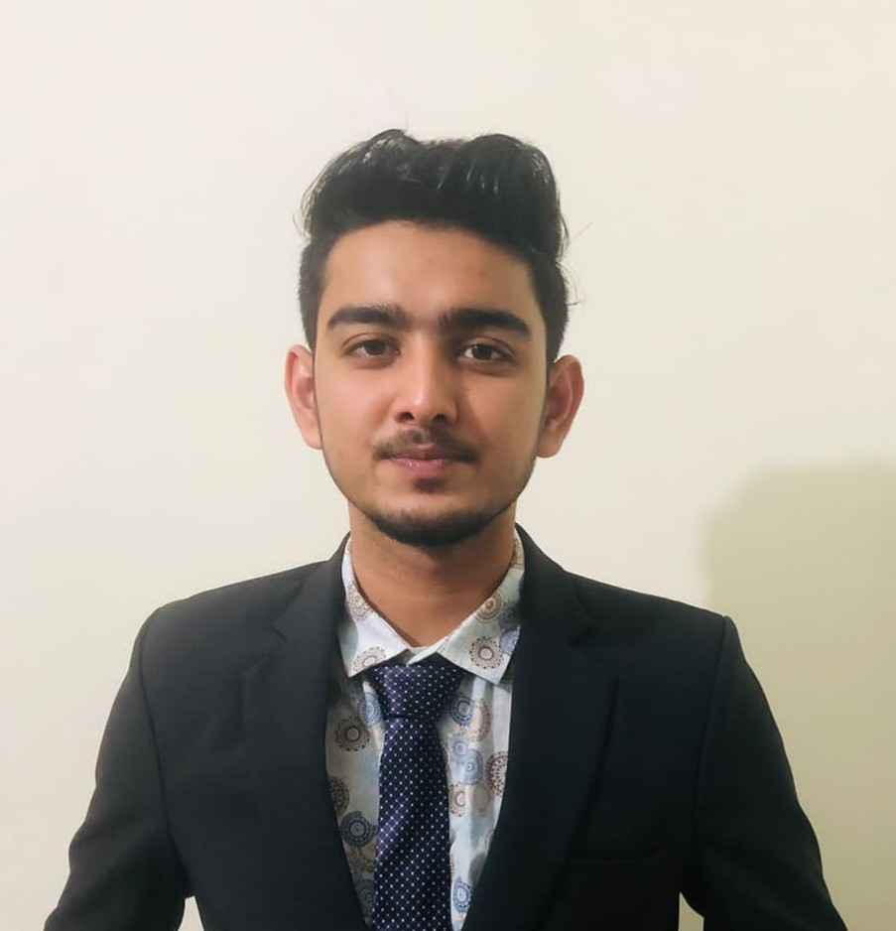
Joy Debnath
Address: Block-G, Road-05, House-644, Bashundhara R/A, Dhaka-1229
Contact: 01628951601
Email: joydebnath4251@gmail.com
Profile summery
Strategic marketing assistance works confidently in a rapidly changing, fast-paced and result oriented corporate environment. Utilizes excellent written and verbal communication skills to assists marketing operations. Concentrates on increasing customer satisfaction. Dynamic marketing professional plans adequately to make maximum use of all resource. Solid background in developing technique to guarantee new strategic promotional operation. Successfully creates flexible campaigns to meet changing opportunities.

Slide 3
EXPERIENCE
February 2022-I currently work here
Marketing Assistant Joy Debnath | California, United States
Worked with supply vendors to secure brand partnerships, promoting
artist supplies and techniques.
Managed social media engagement with timely responds to
messages and comments across all platforms.
Prepared PowerPoint presentations to convey new ideas, status updates and campaign pitches.
EDUCATION
September 2021 - Current
Bachelor of Business Administration | Marketing
Independent University, Bangladesh, Dhaka, Bangladesh
July 2017 February 2019
A-Levels | Commerce
Dhaka commerce college, Mirpur, Dhaka

Slide 4
LANGUAGES
English : C1 : Advanced
Bengali : C2 : Proficient
Hindi : A2 : Elementary
Spanish : A1 : Beginner
HOBBY AND INTERESTS
Working on finding new ideas
Discussing on some new business
Watching movies and series
Watching football
Swimming,
.racking
Consulting others.
Solution searching
and cricket

Slide 5
SKILLS
Script reading
Stage direction following
Engaging audiences
Communicative
M/S Excel
M/S Word
M/S Power Point
Marketing strategy

